Slide 1

D3.js
CMPT 384 – Information Visualization
Lab 8
Course Instructor: Debajyoti Mondal
Lab Tutorial Instructor : Arman Heydari( arman.heydari@usask.ca )

Slide 2
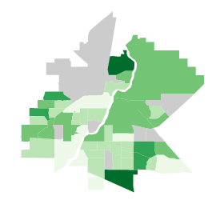


Agenda
D3 Geographic Map (Saskatoon)
D3 Enter, Update and Exit
D3 Zoom

Slide 3
Finding the Right GEOJSON
LIST OF MOST NORTH AMERICAN CITIES AND PROVINCES -
https://github.com/codeforamerica/click_that_hood/tree/master/public/data
CONVERT PUBLICLY AVAILABLE SHAPE FILES INTO GEOJSON -
http://geojson.io/#map=2/20.0/0.0
Finding the Right Data
OPEN-DATA Websites –
http://www.opendatask.ca/data/ - Curated List of all data on saskatoon available for free
http://opendata-saskatoon.cloudapp.net/ - Catalogue of Saskatoon open data
https://data.calgary.ca/ - Calgary open data

Slide 4
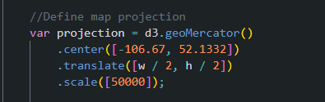
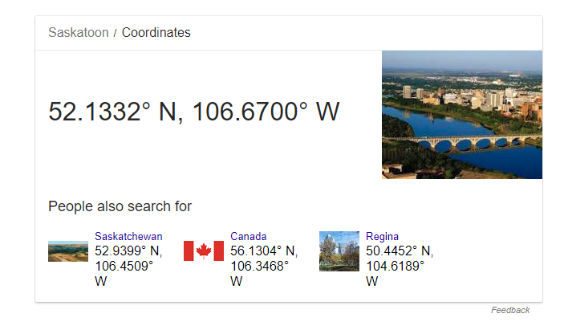
D3 Maps – Centering Projection
Since we are looking at a city scale the projection to a higher value thus zooming into the map.
The default is 1000 for a world level overview.
Since saskatoon is to the west of the Prime (Greenwich) meridian , the value is negative.
Similarly a latitude south of the Equator would be negative

Slide 5
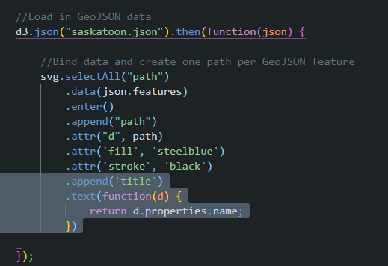
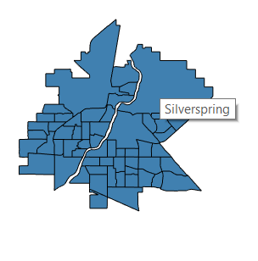
Text on Mouse Hover
Title is SVG’s way of creating a tooltip , the way this looks however can be dependent on the browser .

Slide 6
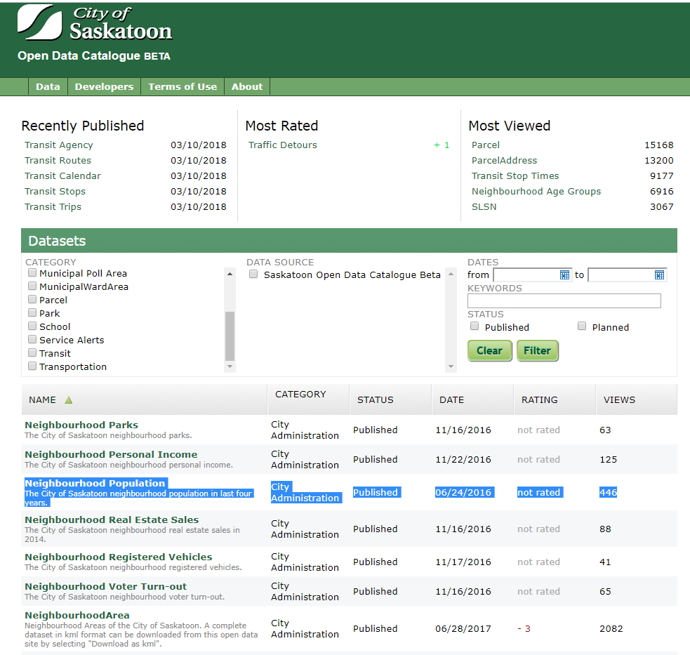
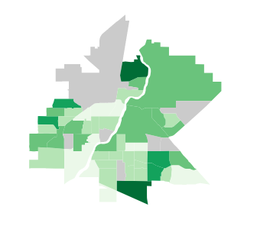
Merging Data with Maps
Example 2 – Map Saskatoon – Population for 2015

Slide 7
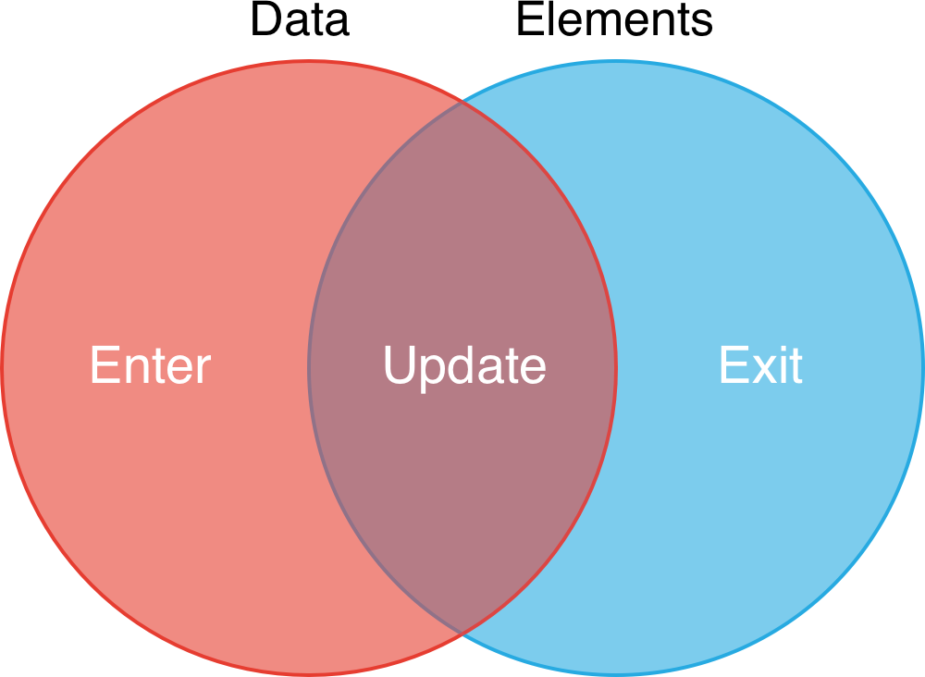



D3 : Enter - Update - Exit Pattern
0. Initial
1. Enter
2. Update + Enter
var svg = d3.select(‘body’)
.append(‘svg’)
svg.selectAll(‘circle’) .data(dataset)
0. dataset = []
dataset = [25, 10]
dataset = [25, 25, 10]
dataset = [10]
3. Update + Exit
Reference - https://www.smashingmagazine.com/2018/02/react-d3-ecosystem/

Slide 8
3 Scenarios on Data Update
The initial dataset and the next dataset have the same number of datapoints – Update the elements with new attributes
The next dataset has more elements – Enter + Update , create new elements and update existing ones with new attributes
The next dataset has fewer elements – Exit + Update , Remove elements that no longer exist in the new dataset and update the remaining ones

Slide 9


EXIT + UPDATE PATTERN
INITIAL DATASET - [3, 2, 1, 5, 6]
NEXT DATASET - [4,3,1]

Slide 10

ENTER + UPDATE PATTERN
INITIAL DATASET - [3, 2, 1, 5, 6]
NEXT DATASET - [5, 1, 1, 2, 7, 9]

Slide 11
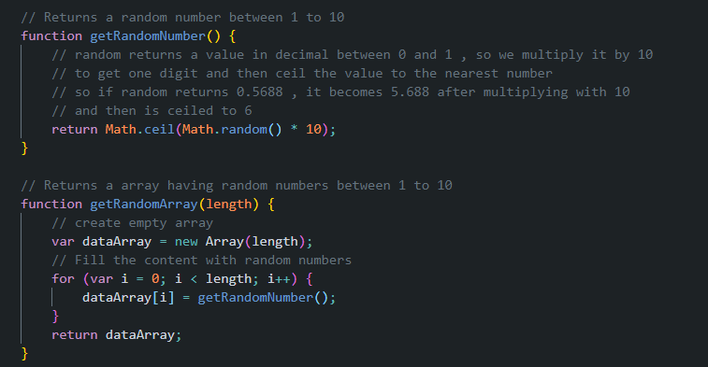
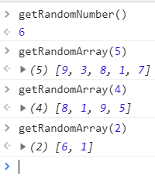
Random Array Generator

Slide 12
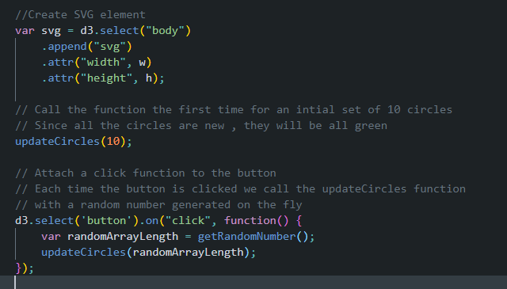
Pass Random Data on Click

Slide 13
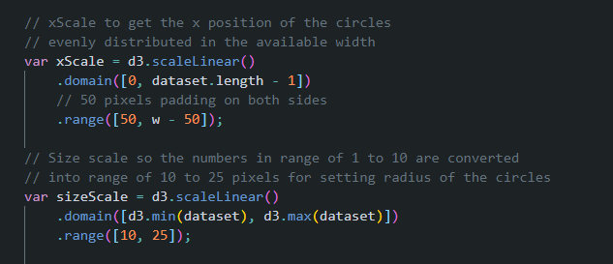
Create Scales for X position and Radius

Slide 14

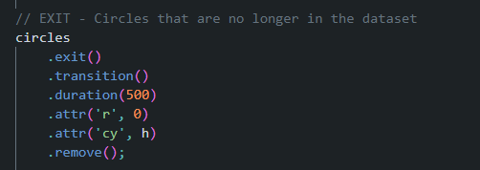
JOIN Data
Get all the circles on the webpage and merge them with the new dataset
Exit Data
Remove circles that are no longer needed smoothly by taking them to the bottom of the screen and also reducing their size via transition

Slide 15
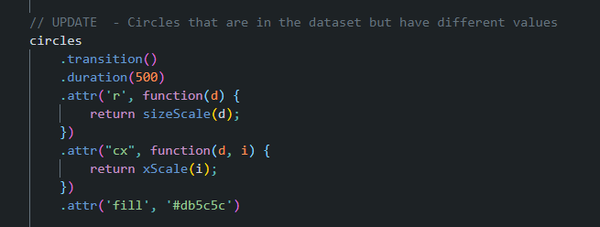
Update Elements

Slide 16
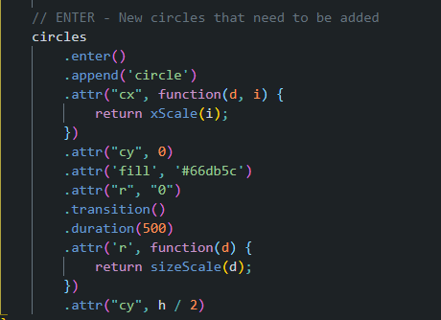
ENTER – New Elements
New Circles are created as dots on the top of the page which is why the cy and radius are initially set to 0
Then they transition to their correct places also while increasing in size to their actual radius.

Slide 17
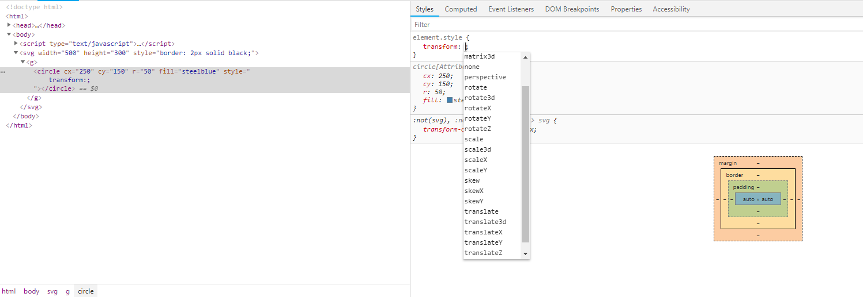
SVG Transform Property
For zoom effect we will use a mixture of Scale and Translate .
Scale creates the actual zooming while Translate is for panning the zoomed image so the zooming is happening with respect to the mouse cursor position

Slide 18
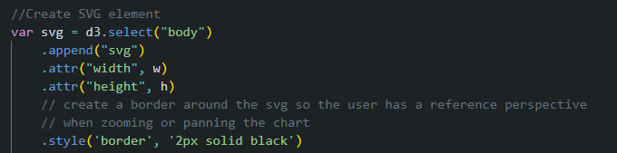
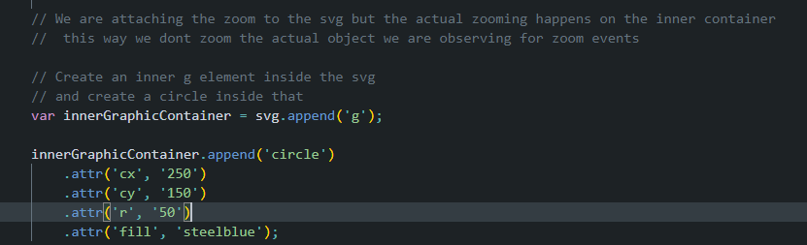
D3 – Zoom
Initial SVG given black border so user has a reference container while zooming and panning the chart

Slide 19
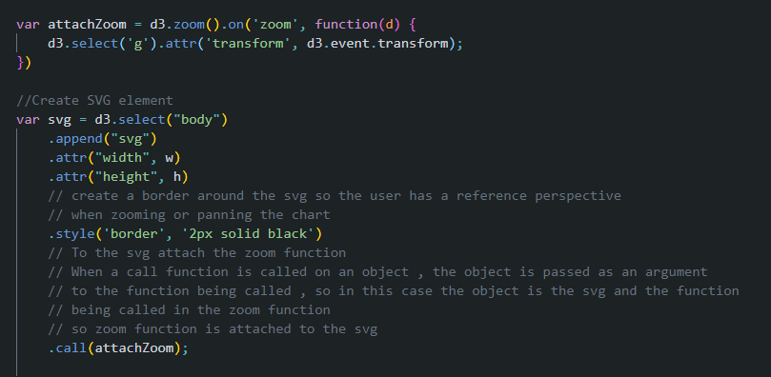
Attaching the Zoom Callback

